Slide 1
Online Temple Pass System
Project Done By-
Mohit Pardeshi
Chetan Pawar
Yogesh Mankar

Slide 2
Abstract
Temple Management System is web-based application which help temple administration to store the data of users(devotees), manage devotee’s donation and manage darshan booking. The system is also intended to provide better services to users (devotees), provide meaningful, consistent, and timely data and information and finally promotes efficiency by converting paper processes to electronic form.
The system was developed using basic technologies such as MySQL database and PHP. The system is free of errors and very efficient and less time consuming due to the care taken to develop it.
All the phases of software development cycle are employed and it is worthwhile to state that the system is user friendly and strong.
Provision is made for future development in the system.

Slide 3
Introduction
Online Temple Management System is software which is helpful for temple administrator and devotees. In the current system all the activities are done manually. It is very time consuming and costly. Our Online Temple Management System deals with the various activities related to the temple and devotees.
The two main users involved in this system are
User(i.e., Devotees)
Admin

Slide 4
Admin Module
Dashboard: In this section, admin can see all detail in brief like Total new darshan booking, accepted darshan booking, rejected darshan booking, total donation, total temple and total festivals.
Temple: In this section, admin can manage temple (Add/Update/Delete).
Festivals: In this section, admin can manage the festivals (Add/Update/Delete).
Darshan Booking: In this section, the admin can manage darshan booking and update the status of booking.
View Donation: In this section, the admin can view the donation detail and print the receipt.
Reports: In this section admin, can generate the following reports in a particular period
Darshan booking: In this section, admin can generate the between dates reports of darshan booking
Reports of Donation: In this section, admin can generate the between dates reports of donation.
Collected Donation: In this section, admin can generate the report of amount which is collected in a particular temple.
Registered devotees: In this section, admin can generate the between dates reports of devotees who registered themselves with temple organization.

Slide 5
Continue…..
Pages: In this section admin, can manage about us and contact us page of administration
Search: In this section admin, can search following details.
Darshan booking: In this section, admin can search booking detail by booking number.
Donation Receipt: In this section, admin can search booking detail by donation number(receipt number).
Reg Devotees: In this section, admin can search booking detail by mobile number.
Registers Devotees: In this section, admin can view the detail of registered devotees.
Admin can also update his profile, change the password and recover the password.

Slide 6
User (Devotees) Module
Home: It is welcome page for devotees.
Donation History: User can view donation history.
Darshan History: User can view darshan history and darshan booking status.
Profile: User can update his/her profile.
Change Password: User can change the password of their account.
Logout: User can logout from website.
Our Festivals: User can view all the festivals which is celebrated in the temples.
Temples: User can view the temple detail, send the donation and book darshan.
About: User can view about us page.
Contact: User can view contact us page.

Slide 7
User (Non-Register Devotees)
Home: It is welcome page for user.
About: User can view about us page.
Contact: User can view contact us page.
Our Festivals: User can view all the festivals which is celebrated in the temples.
Temples: User can view the temple detail.

Slide 8
Requirement Specification
Hardware Configuration:
Client Side
Server Side
RAM | 512 MB
Hard Disk | 10GB
Processor | 1.0 GHz
RAM | 1 GB
Hard Disk | 20GB
Processor | 2.0GHz

Slide 9
Continue.....
Software Requirement:
Client Side
Server Side
Web Browser | Google Chrome or any compatible browser
Operating System | Windows or any equivalent OS
Web Server | APACHE
Server side Language | PHP5.6 or above version
Database Server | MySQL
Web Browser | Google Chrome or any compatible browser
Operating System | Windows or any equivalent OS

Slide 10
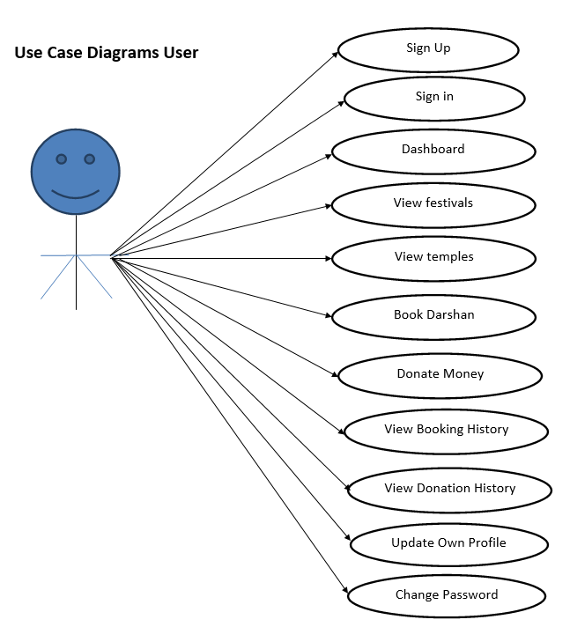
Use Case Diagram
Notes:
USECASE DIAGRAM: A Use case is a description of set of sequence of actions. Graphically it is rendered as an ellipse with solid line including only its name. Use case diagram is a behavioral diagram that shows a set of use cases and actors and their relationship. It is an association between the use cases and actors. An actor represents a real-world object. Primary Actor – Sender, Secondary Actor Receiver.

Slide 11
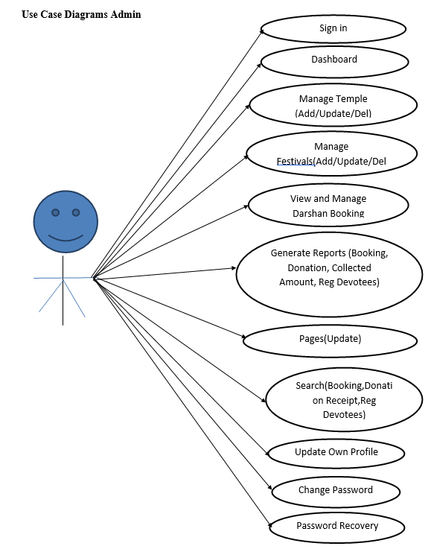
Continue…

Slide 12
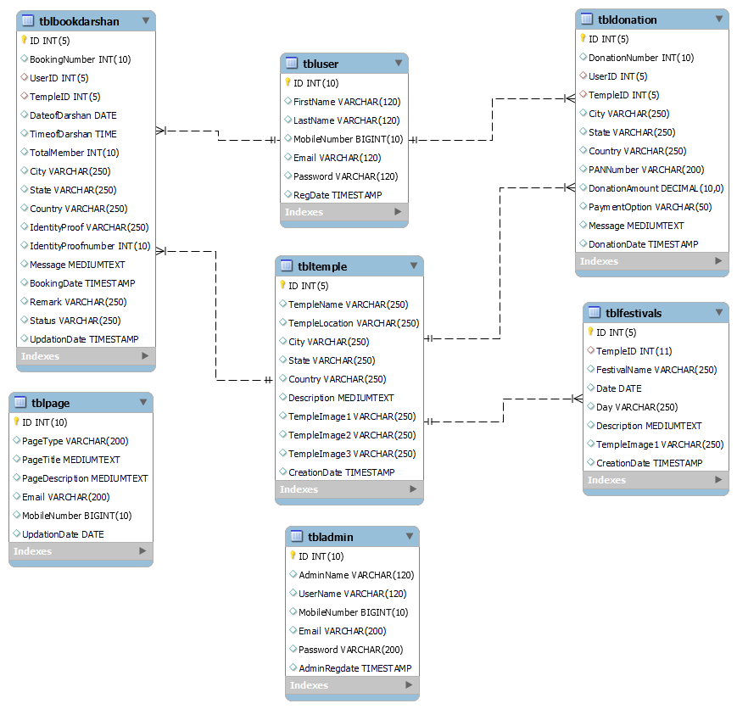
Class Diagram
Notes:
Class Diagram:
A description of set of objects that share the same attributes operations, relationships, and semantics

Slide 13
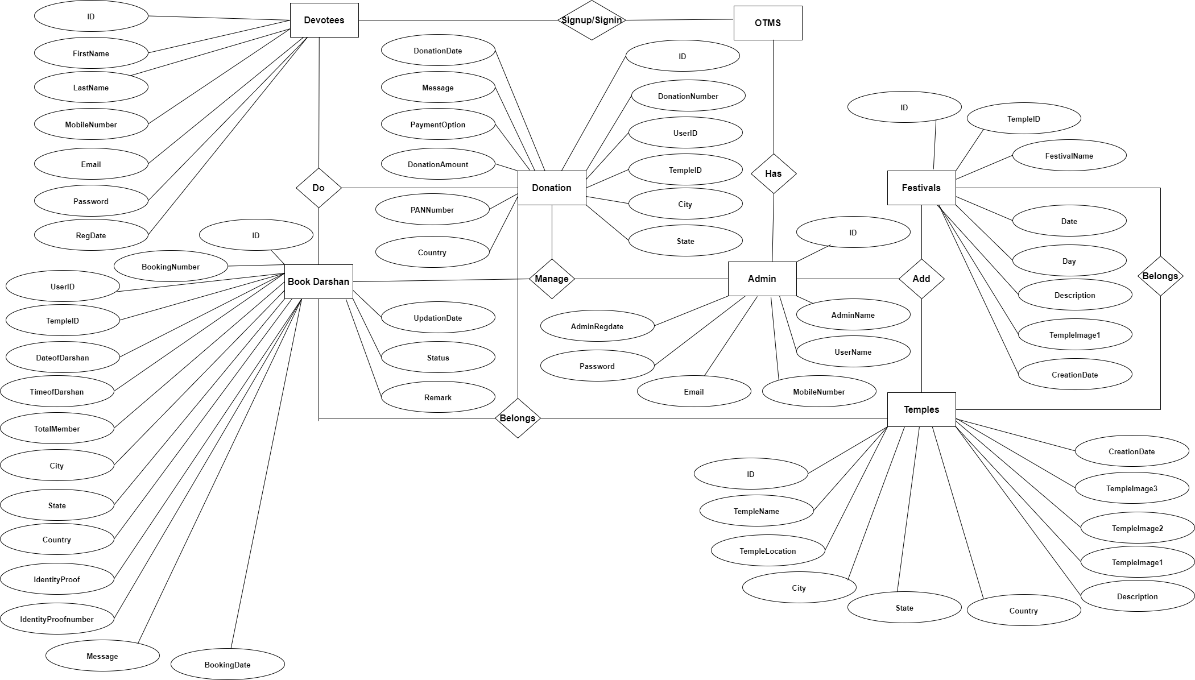
ER Diagram

Slide 14
Data Flow Diagram
A data flow diagram is graphical tool used to describe and analyze movement of data through a system. These are the central tool and the basis from which the other components are developed. The transformation of data from input to output, through processed, may be described logically and independently of physical components associated with the system.
These are known as the logical data flow diagrams. The physical data flow diagrams show the actual implements and movement of data between people, departments and workstations.

Slide 15
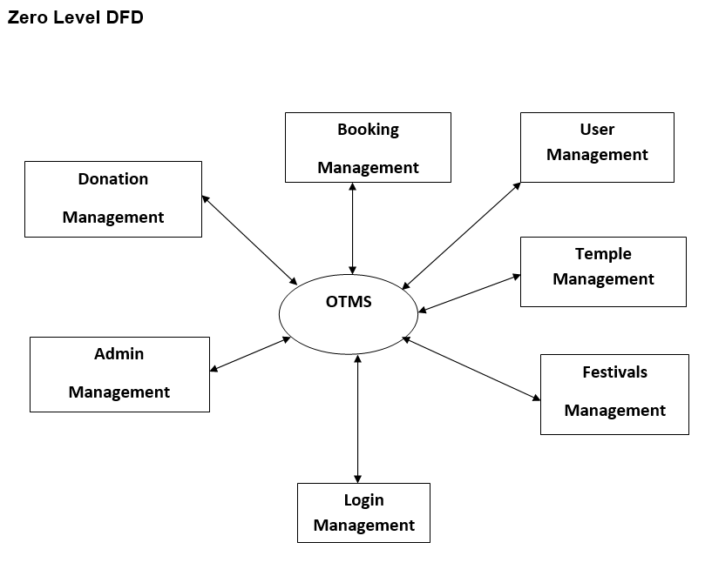
Continue….

Slide 16
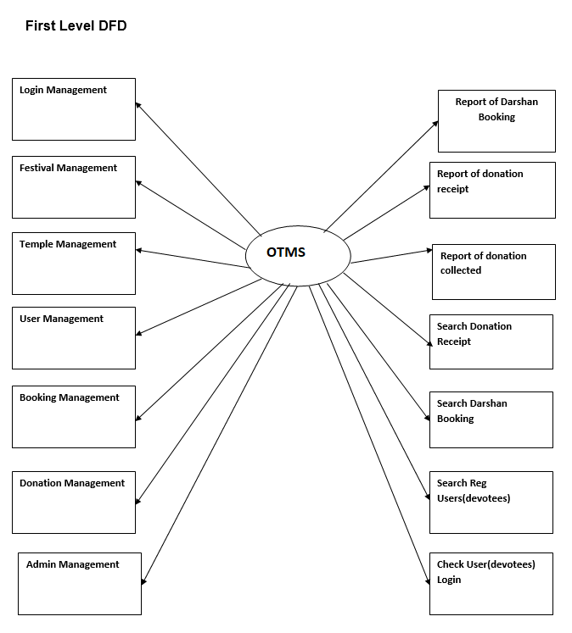
Continue….

Slide 17
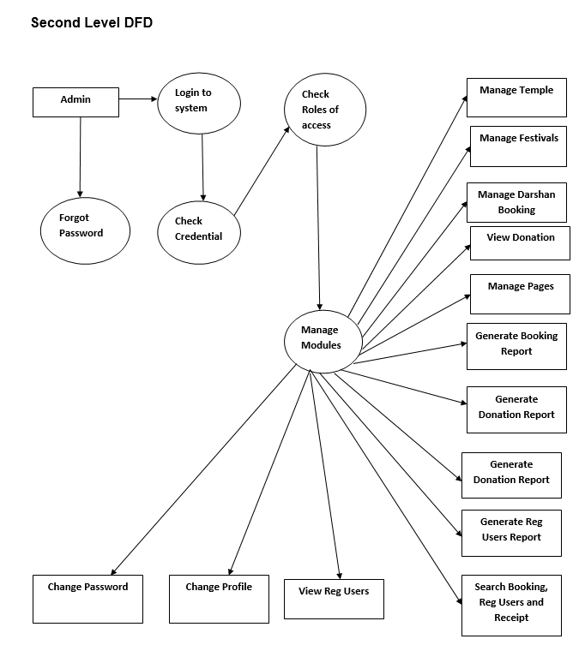
Continue….

Slide 18
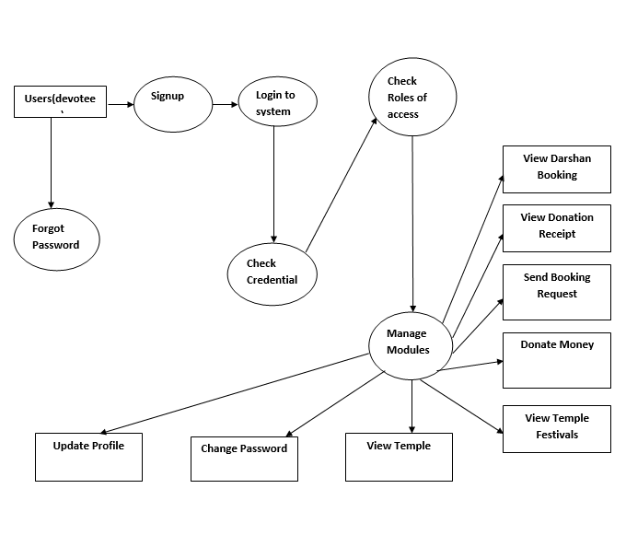
Continue….

Slide 19
Implementation and System Testing
After all phase have been perfectly done, the system will be implemented to the server and the system can be used.
System Testing
The goal of the system testing process was to determine all faults in our project .The program was subjected to a set of test inputs and many explanations were made and based on these explanations it will be decided whether the program behaves as expected or not. Our Project went through two levels of testing
Unit testing
Integration testing

Slide 20
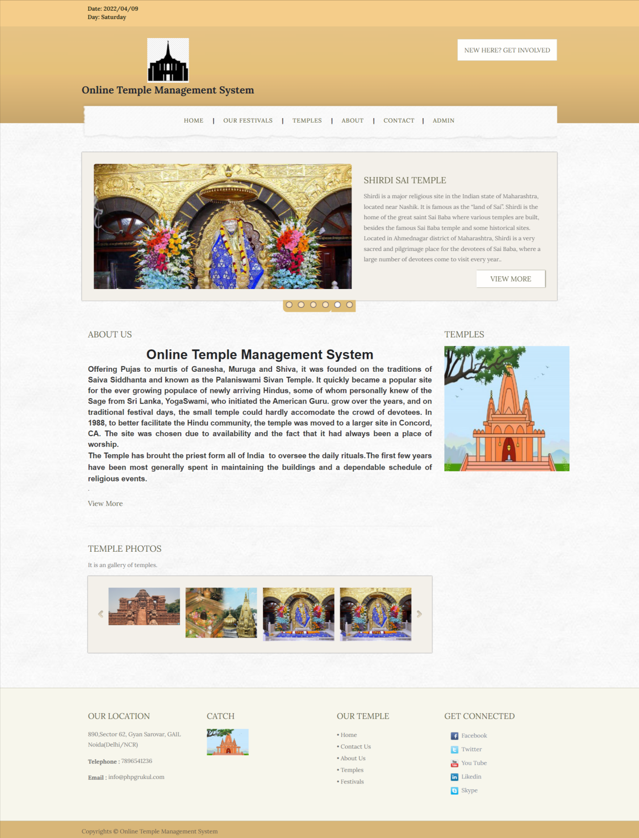
Project Screens

Slide 21
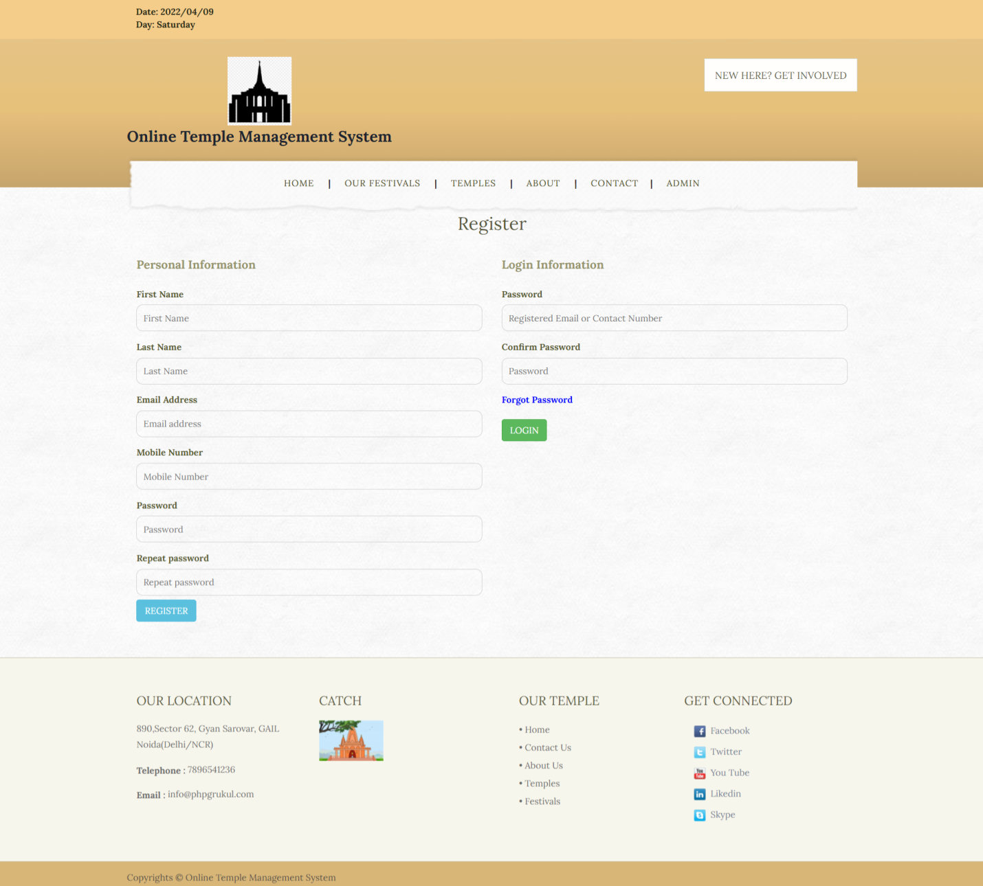

Slide 22
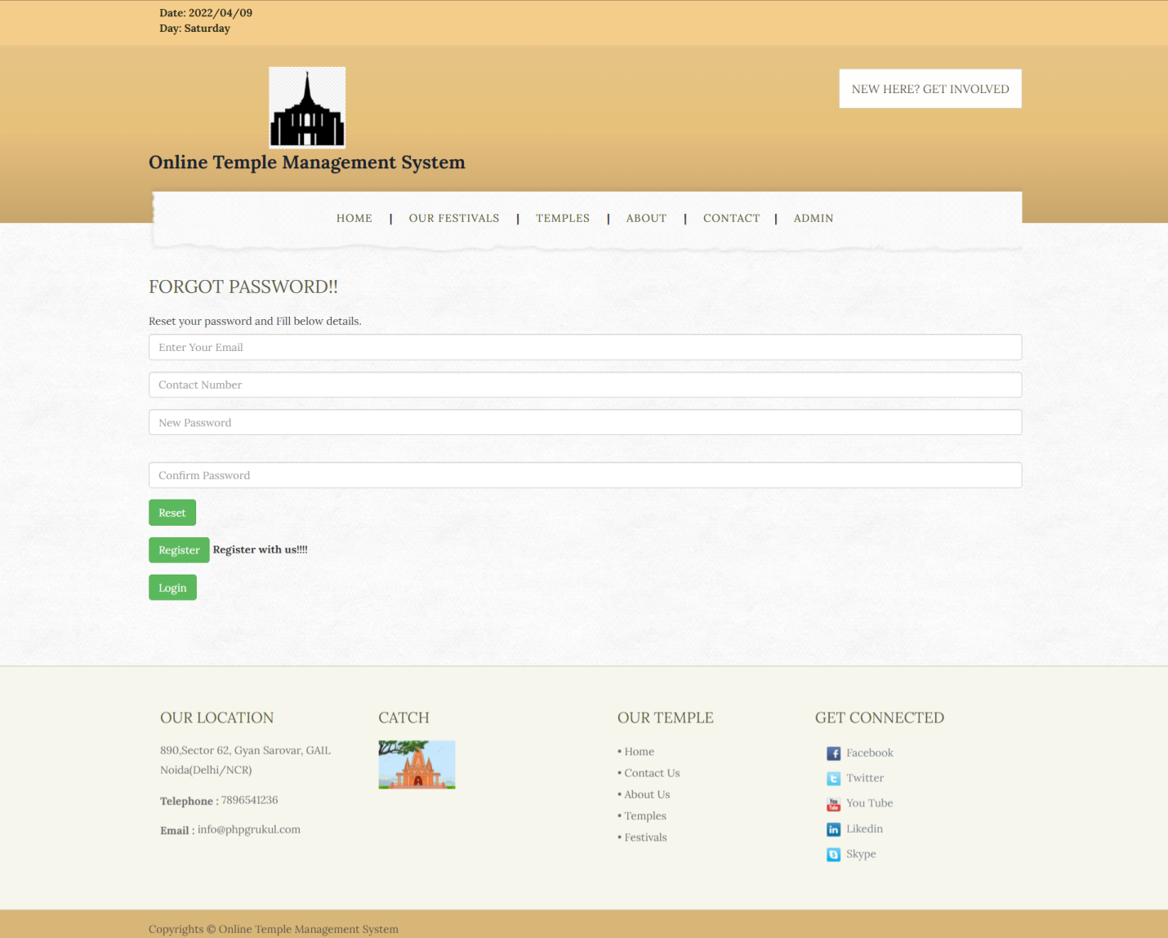

Slide 23
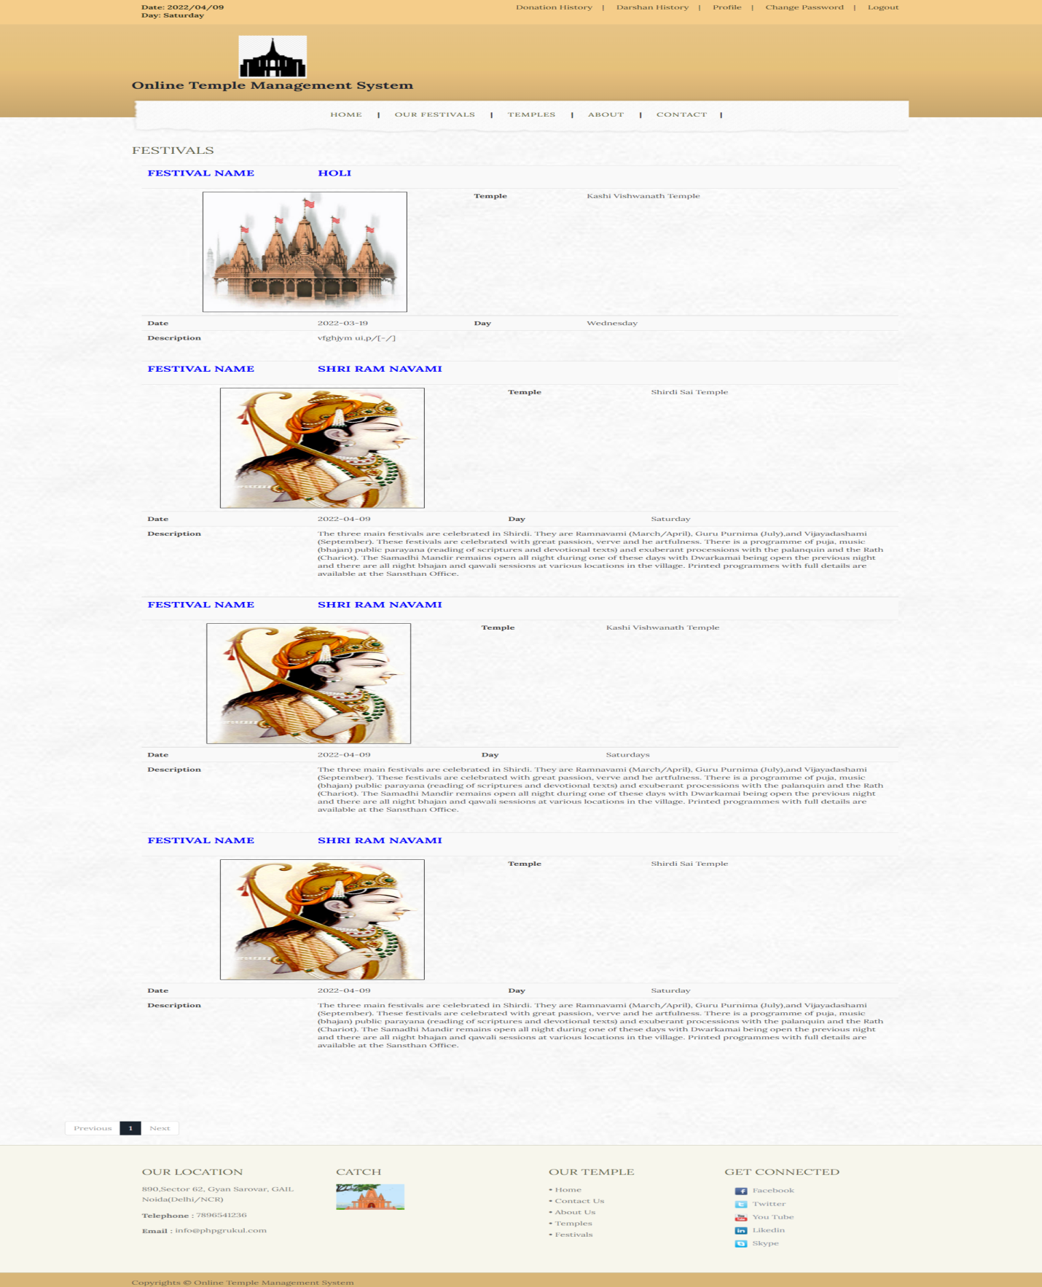

Slide 24
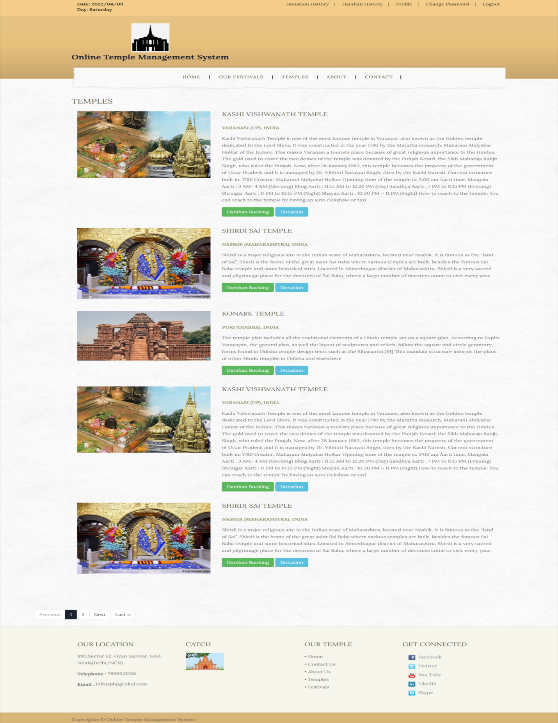

Slide 25
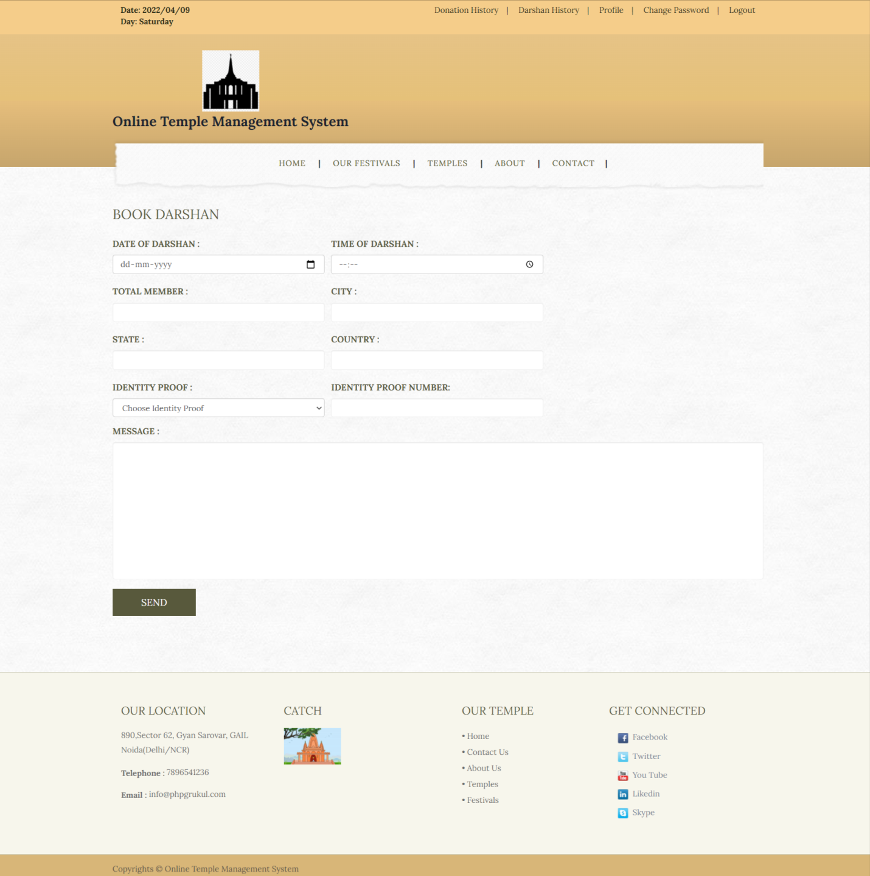

Slide 26
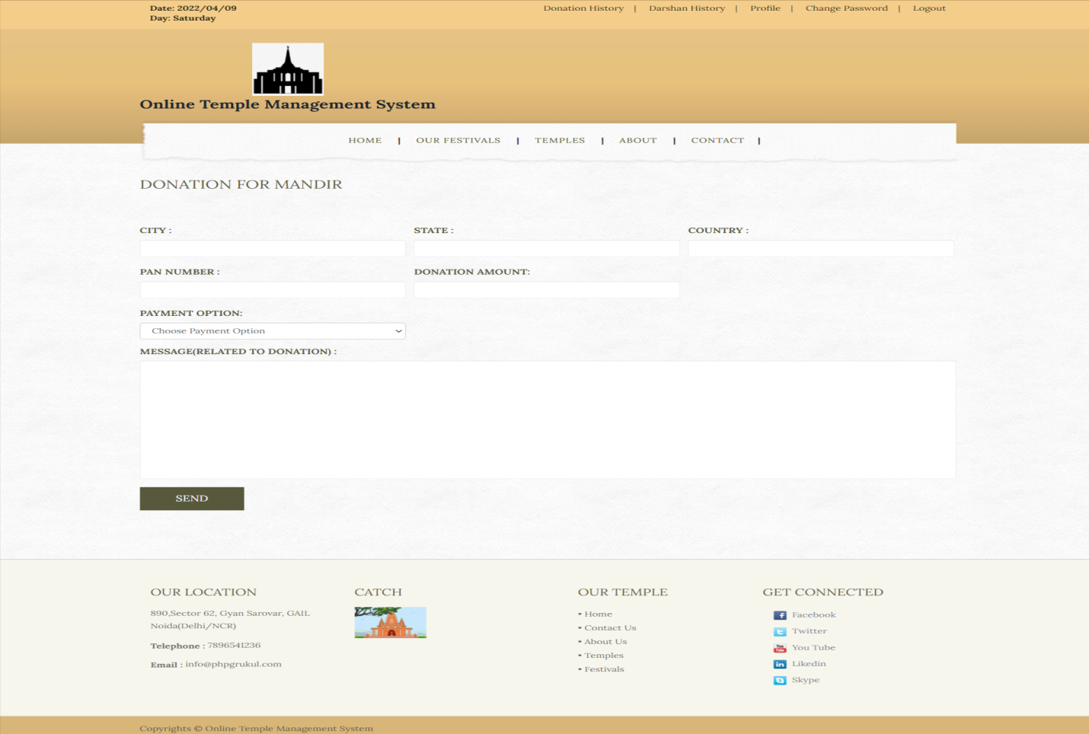
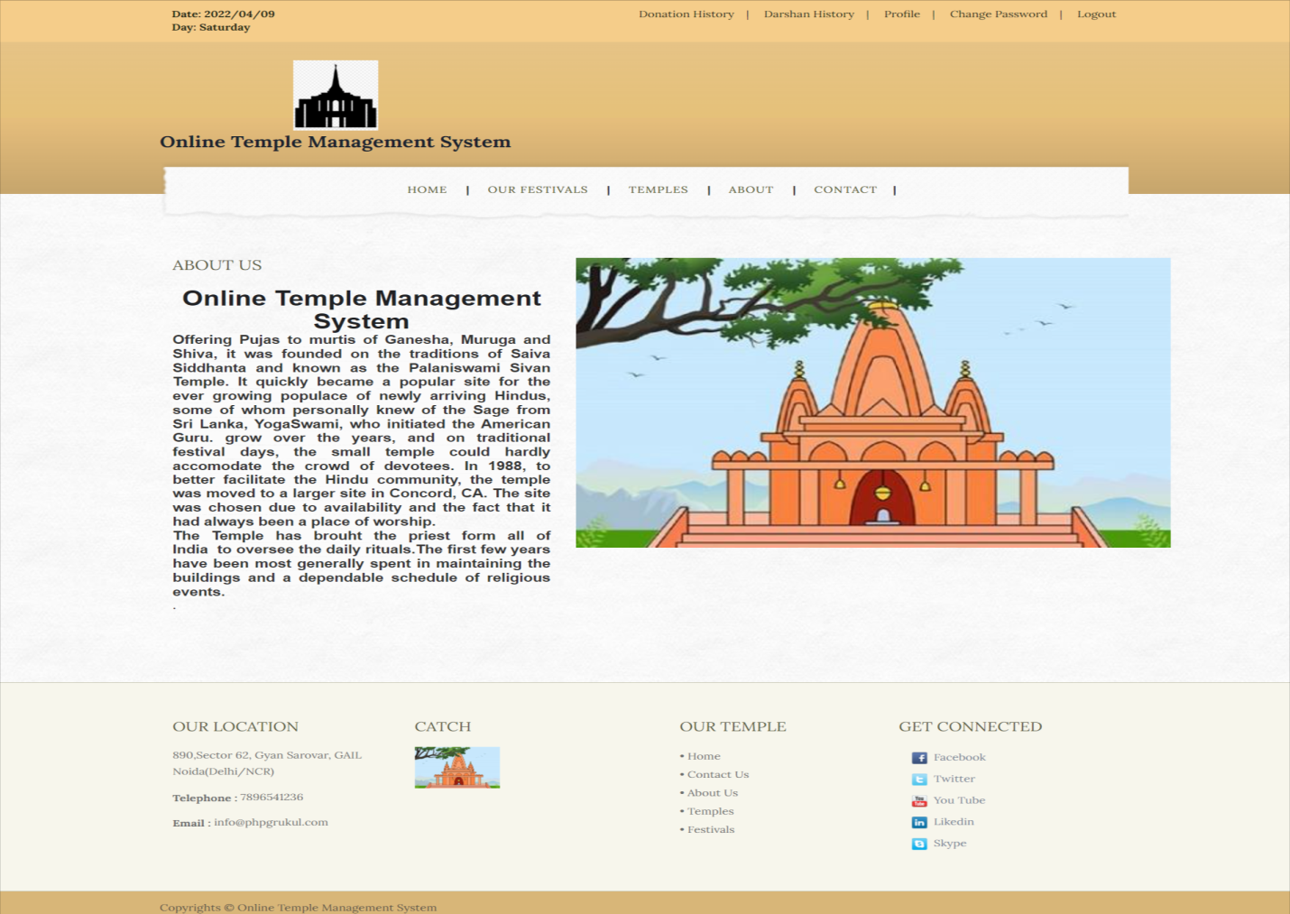

Slide 27
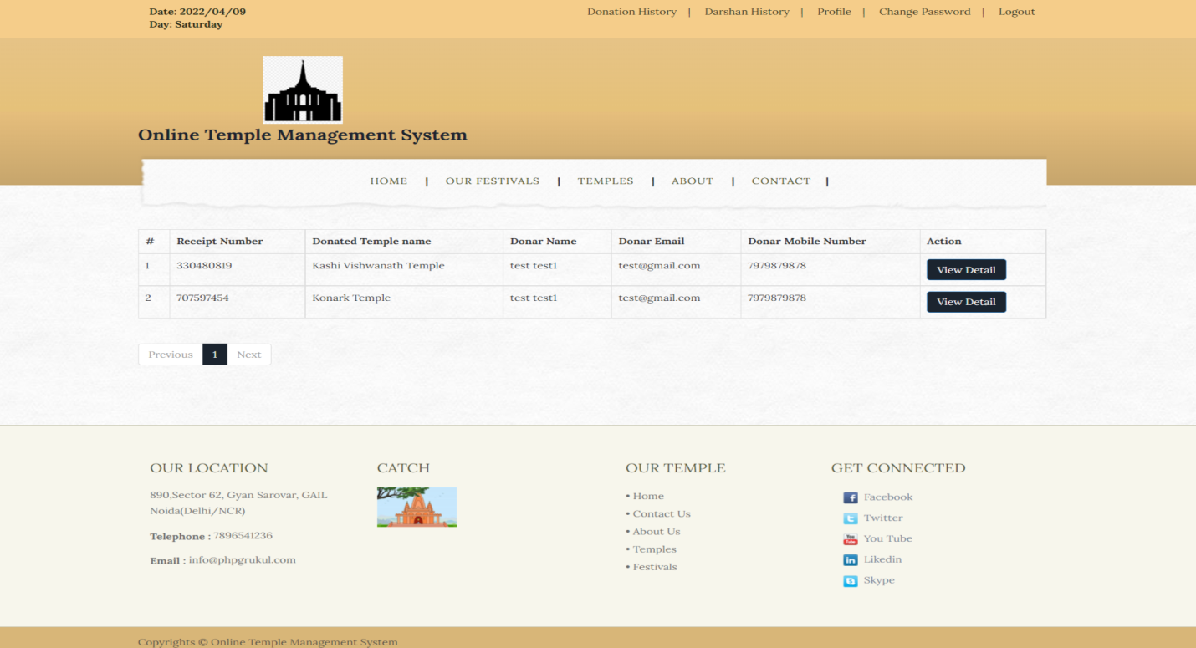
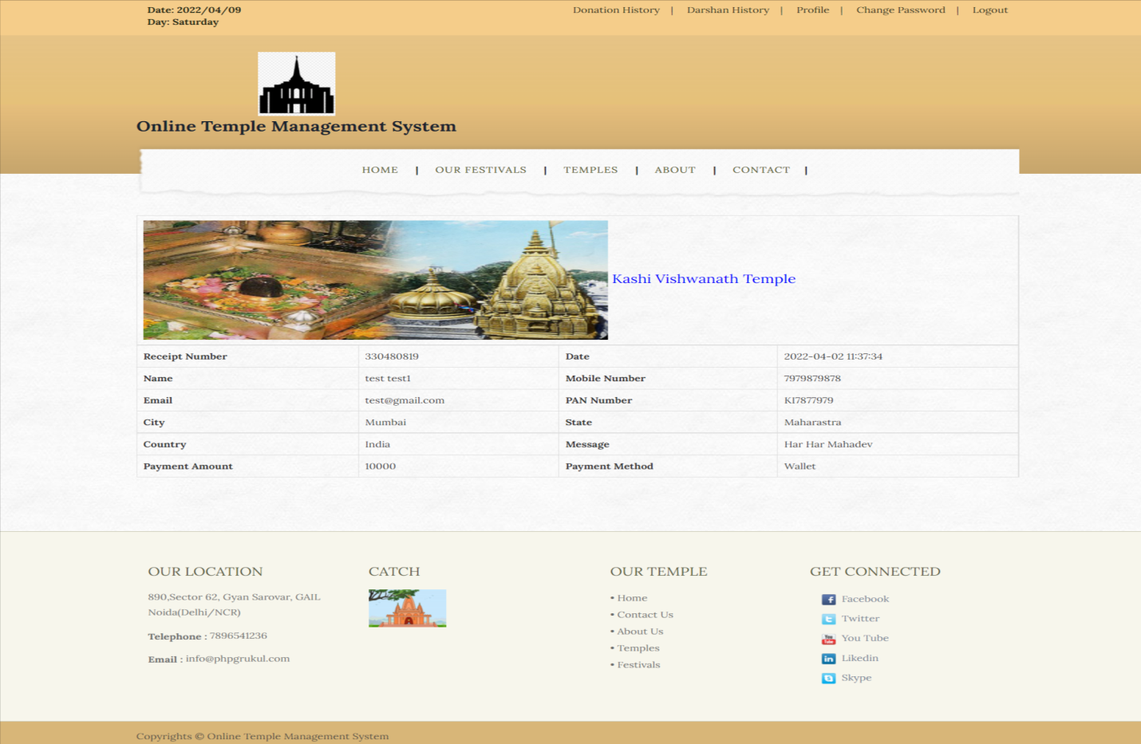

Slide 28
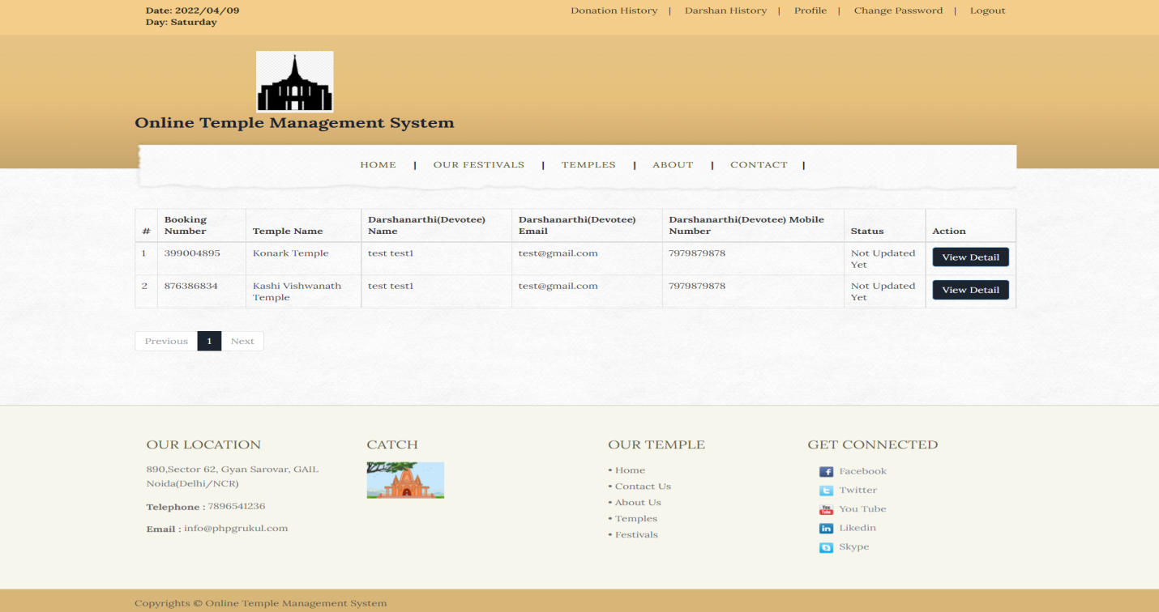
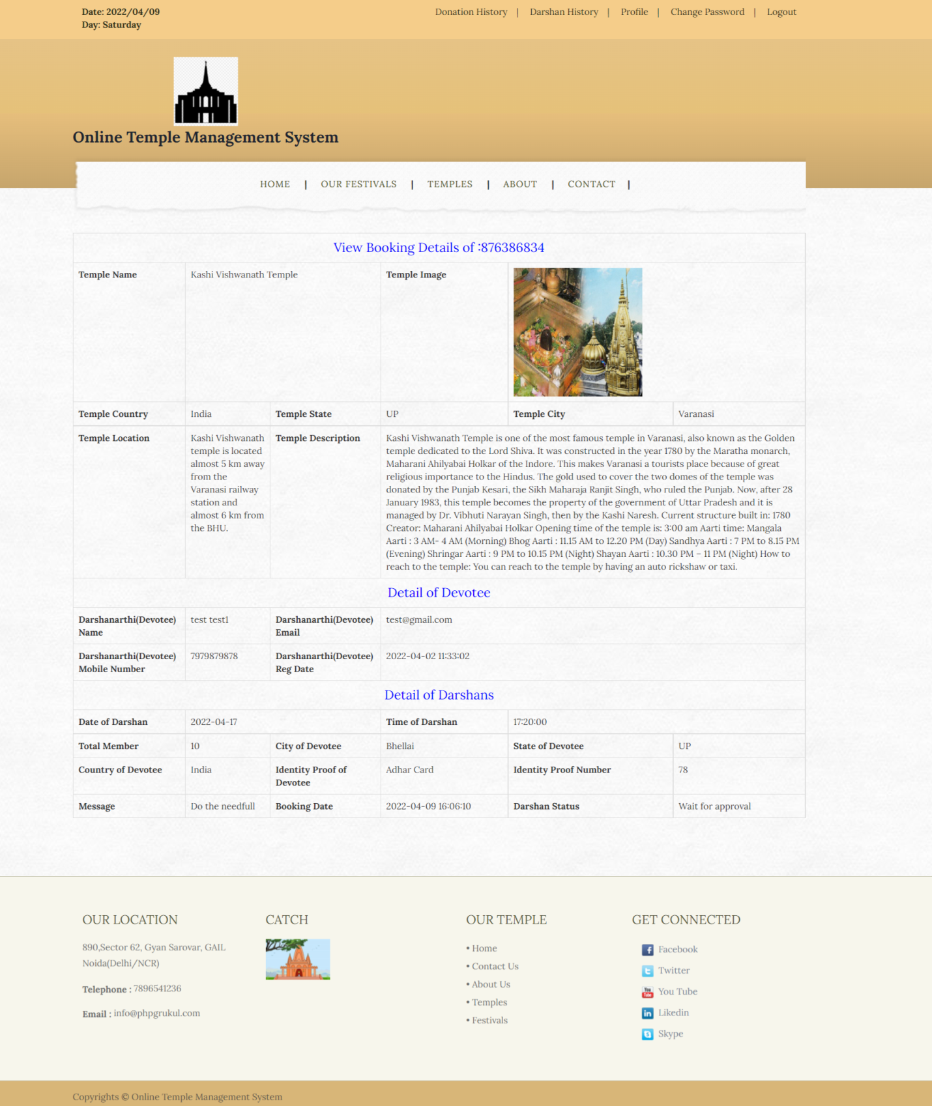

Slide 29
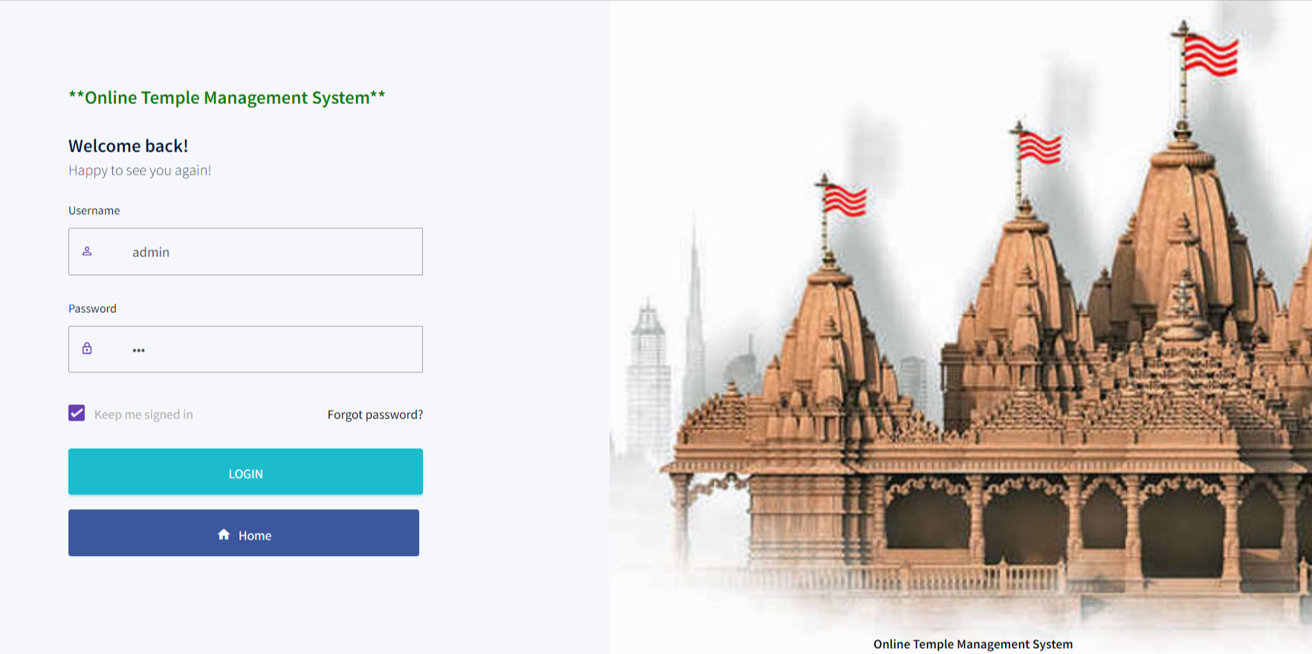
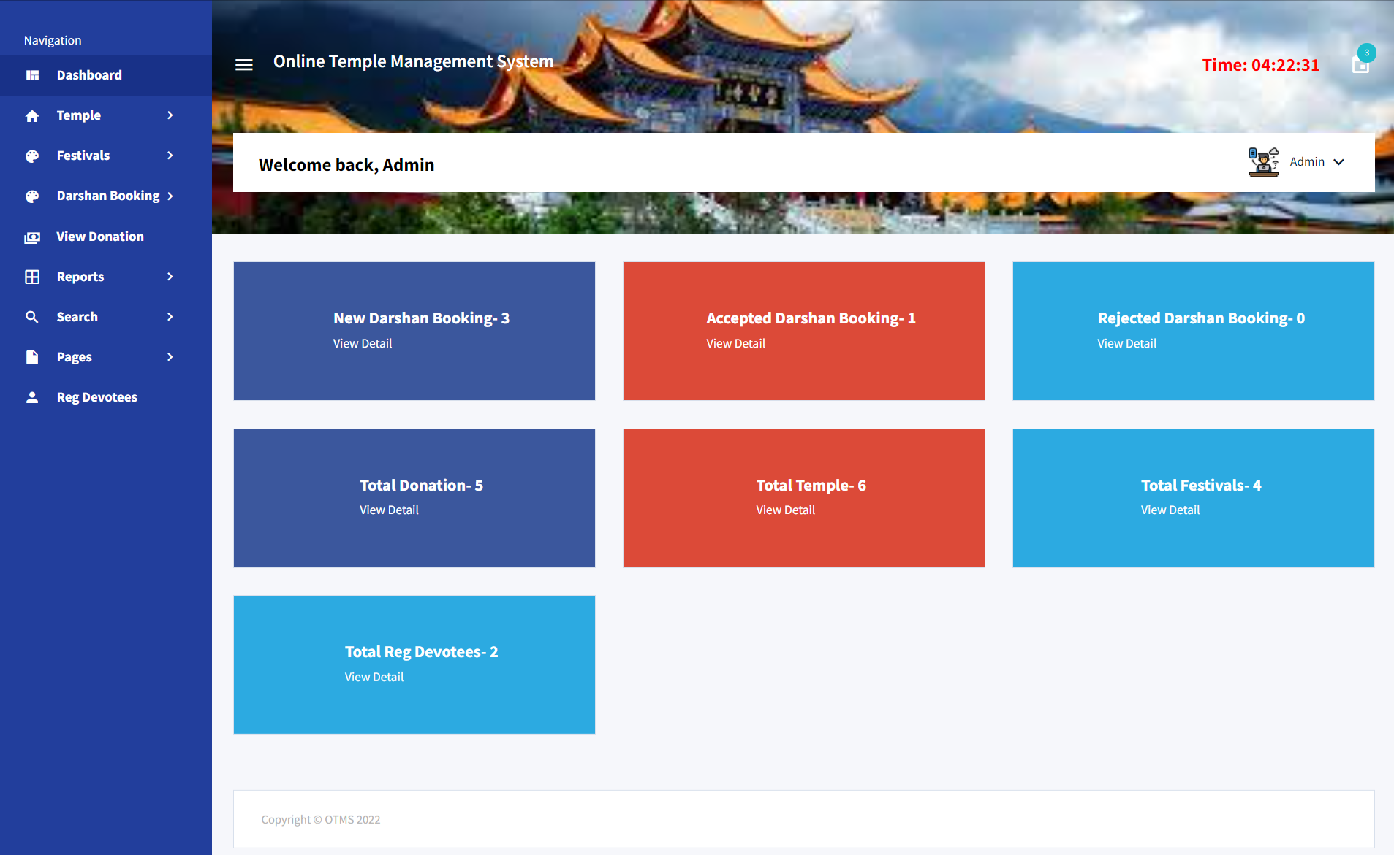

Slide 30
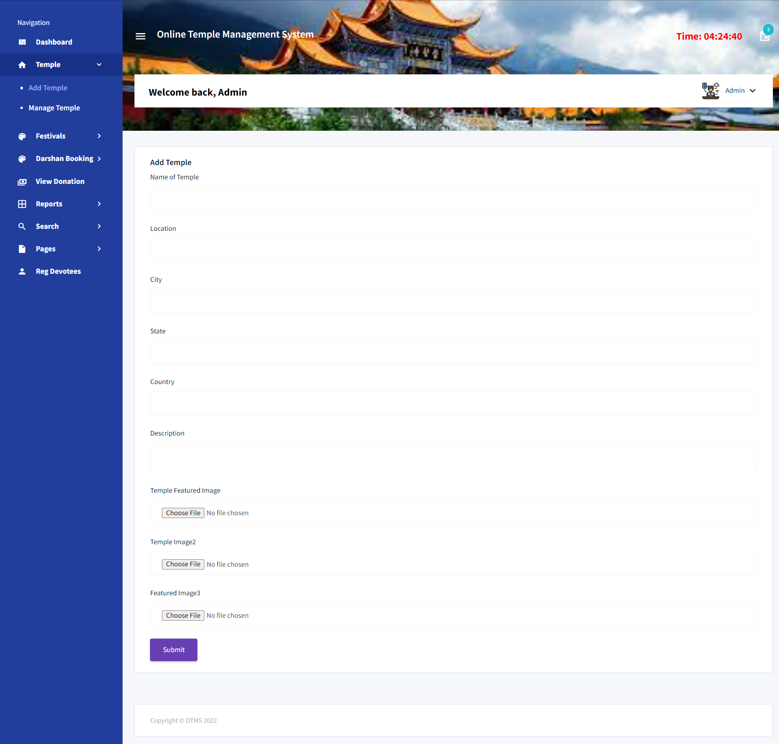

Slide 31
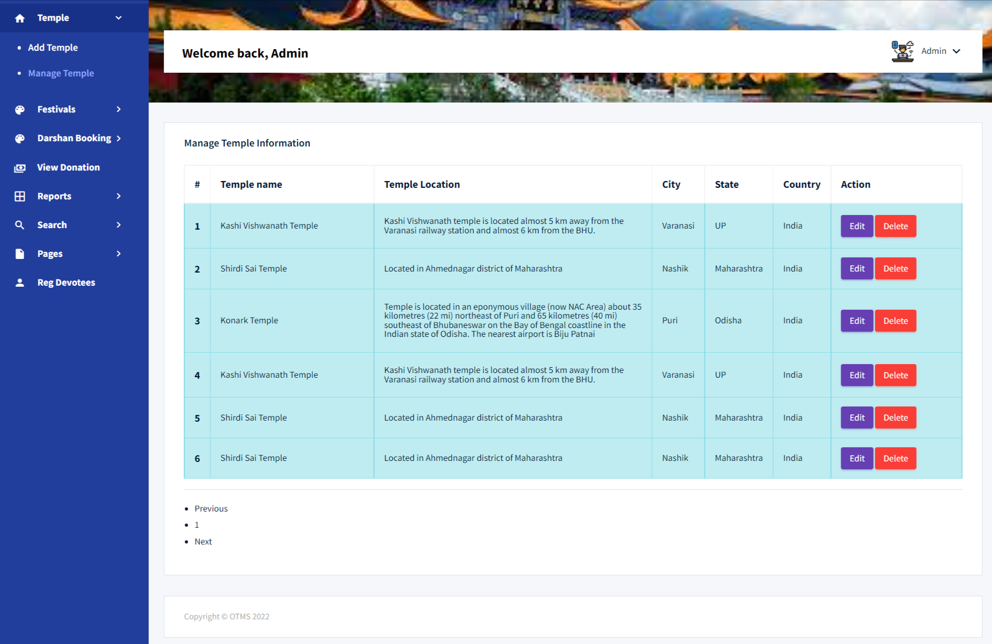
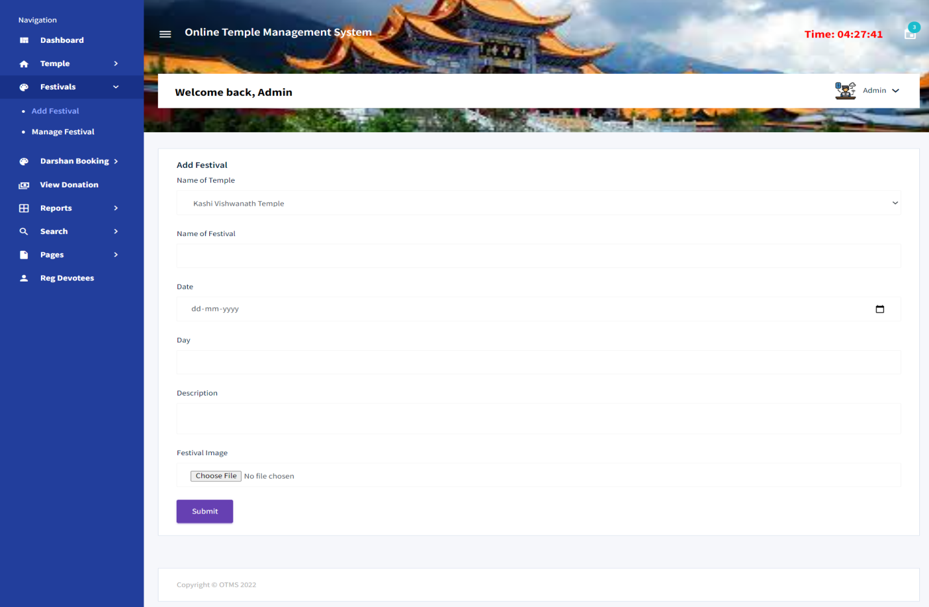

Slide 32
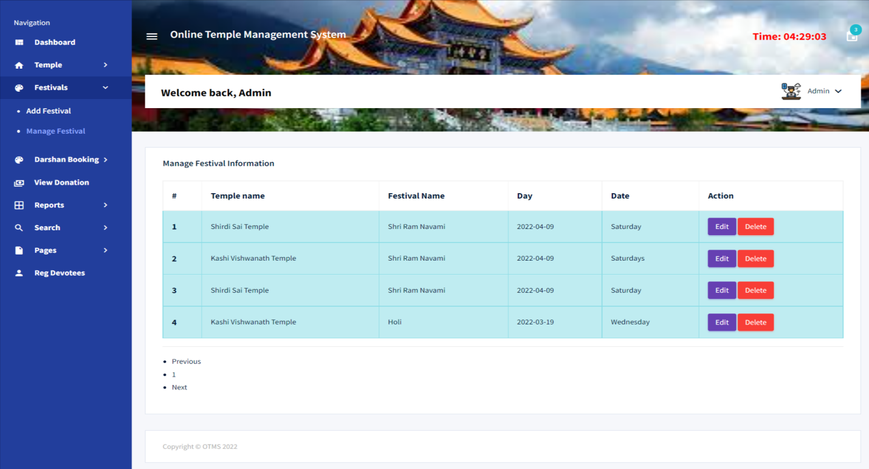
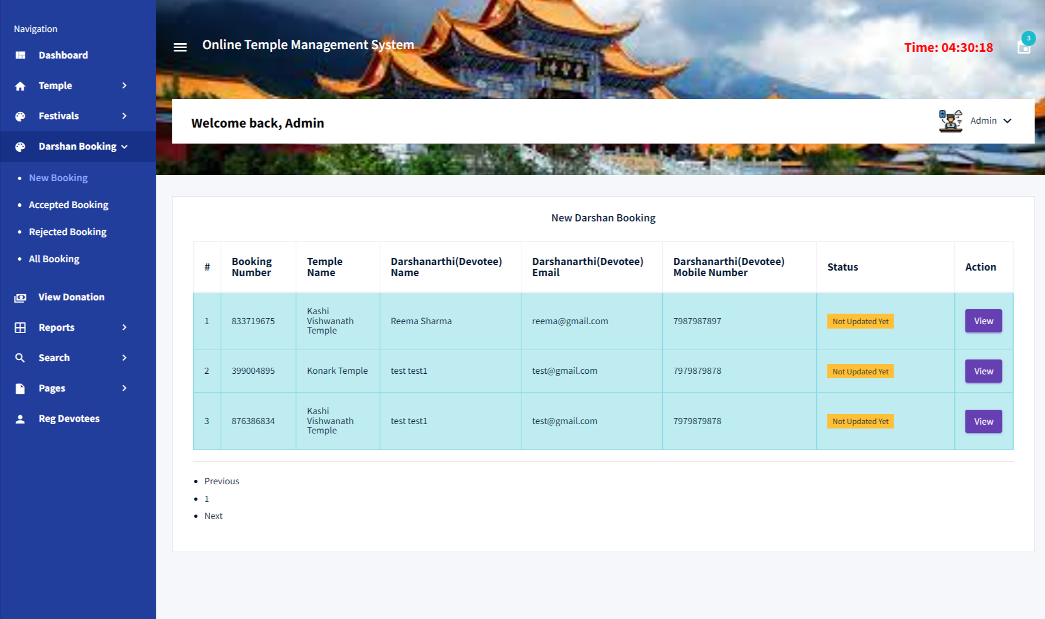

Slide 33
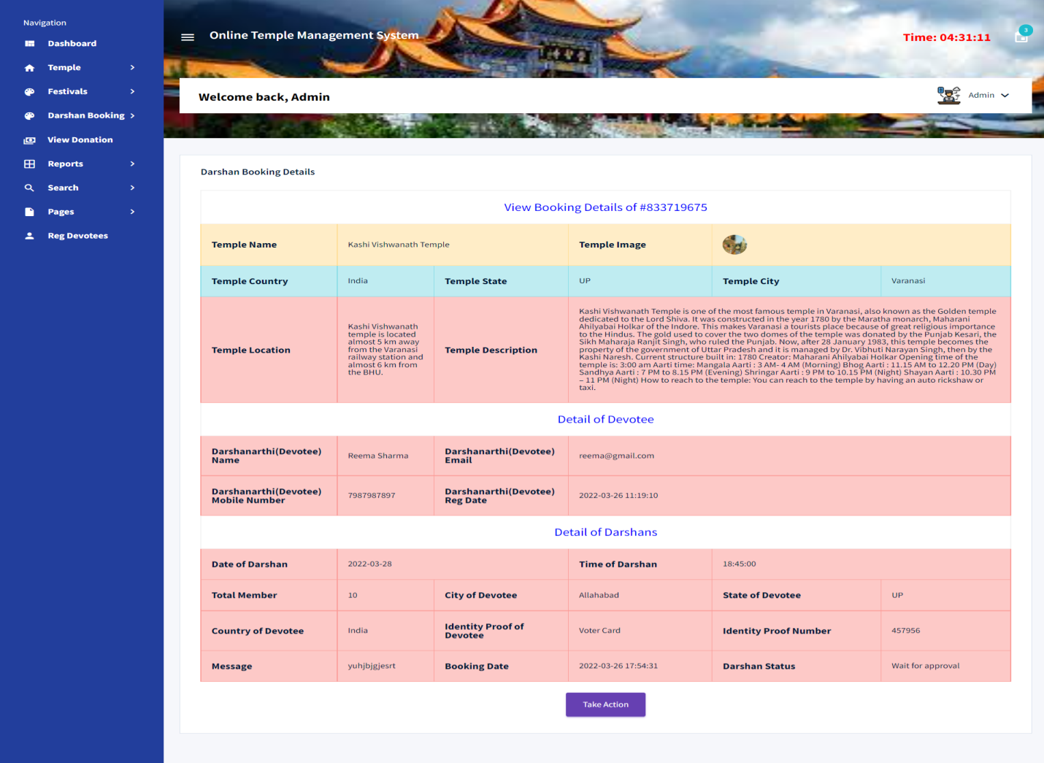

Slide 34
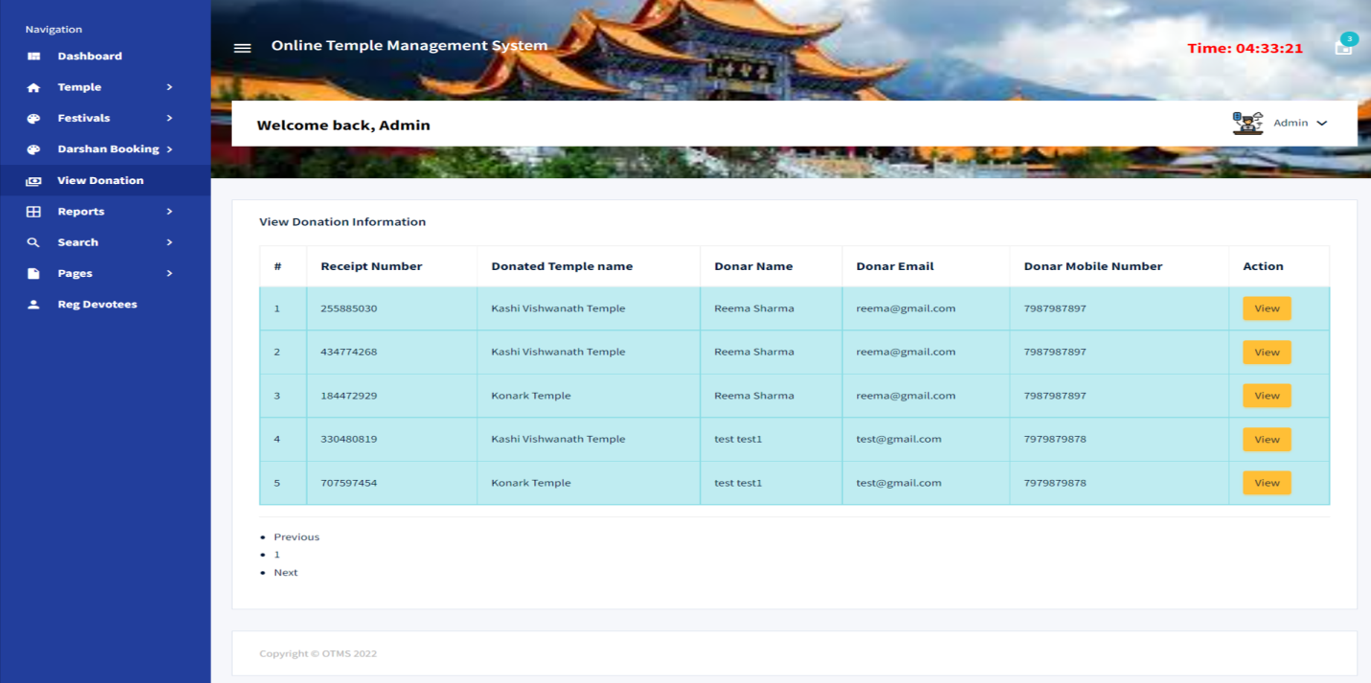
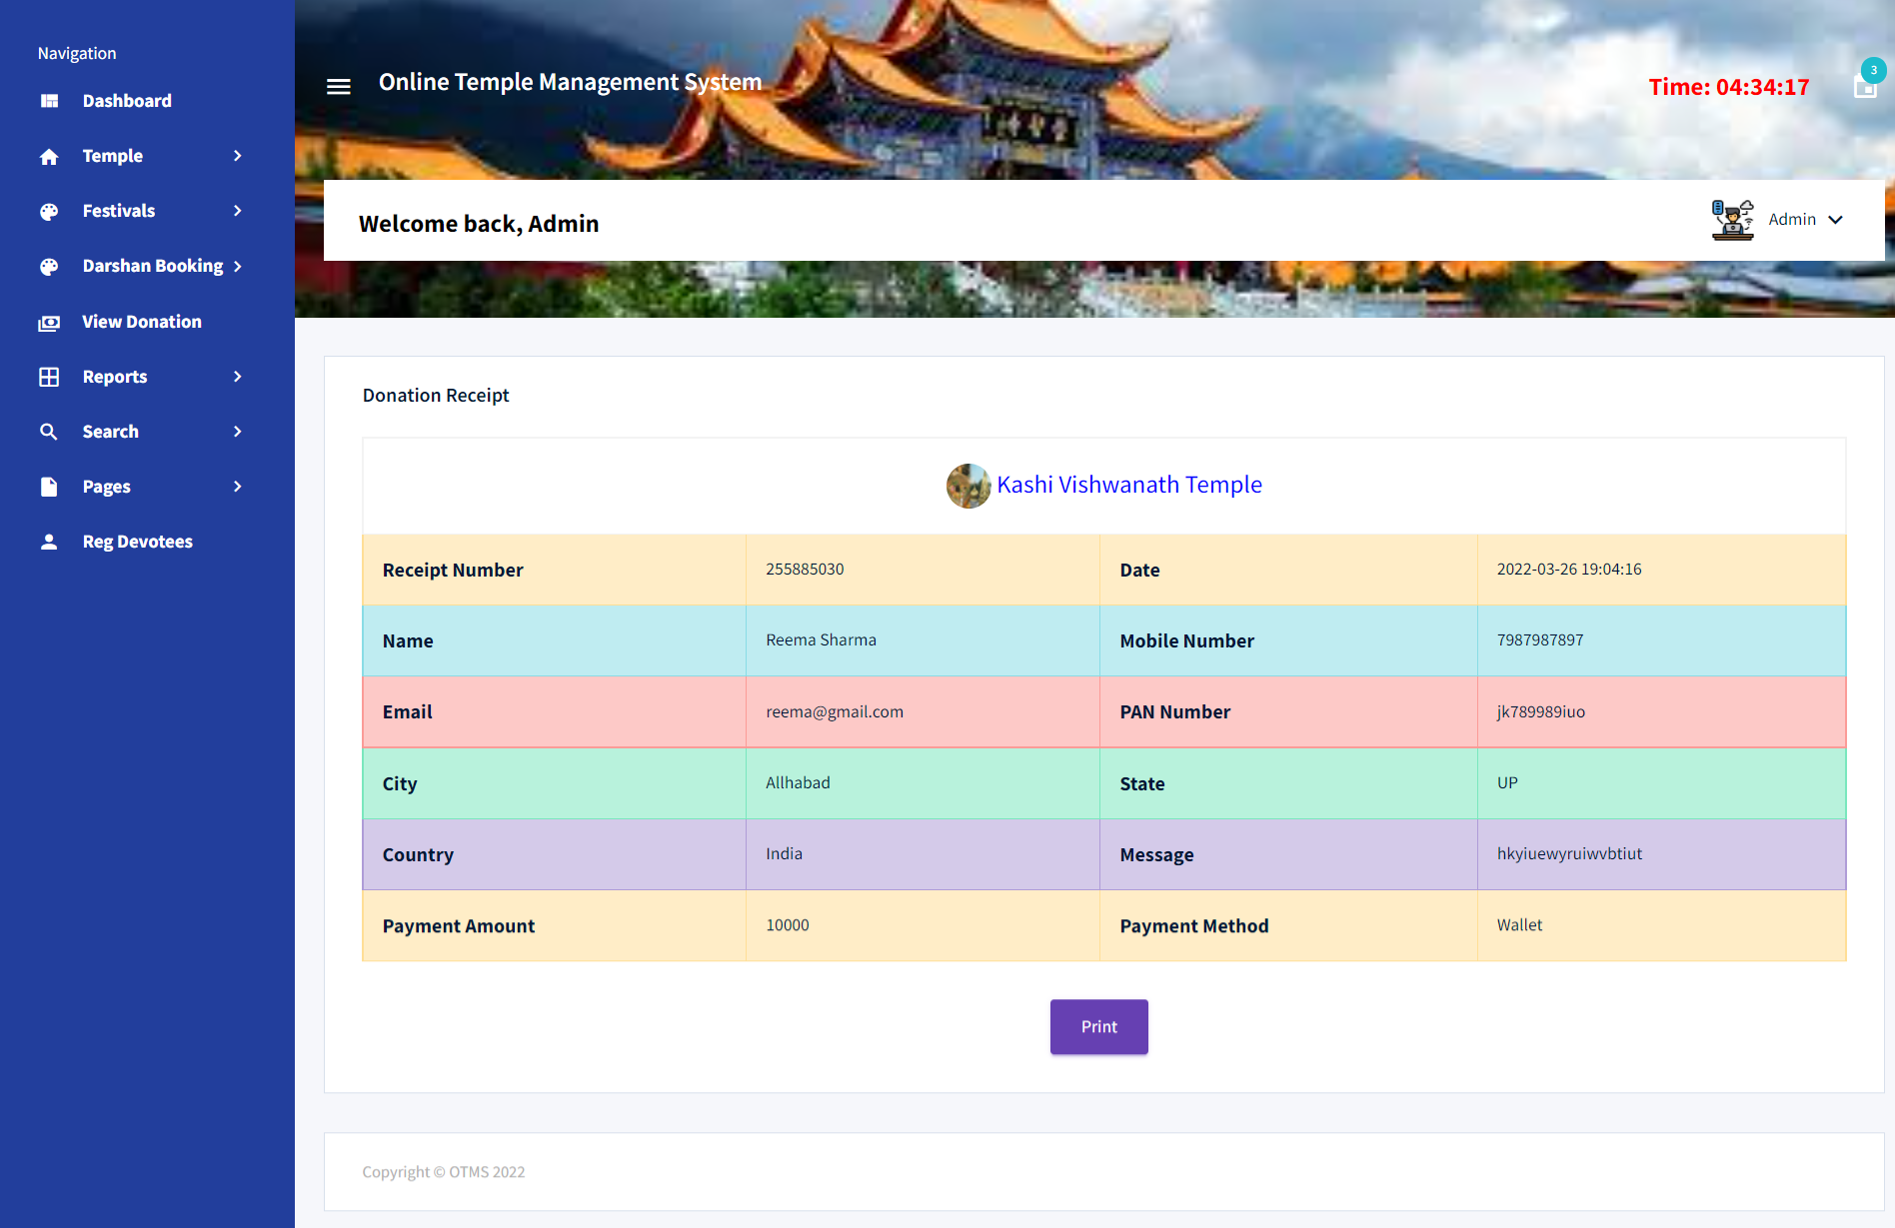

Slide 35
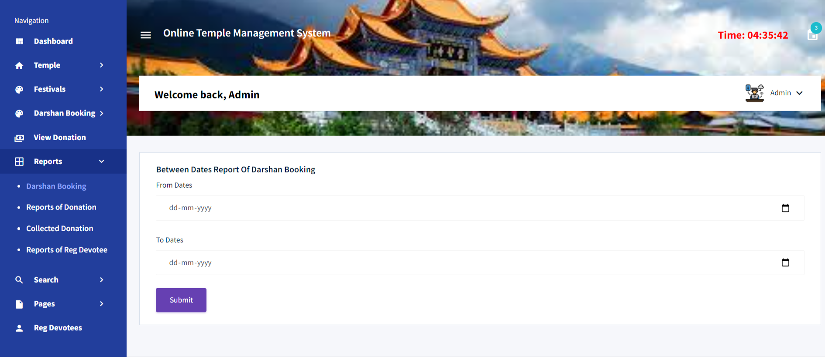
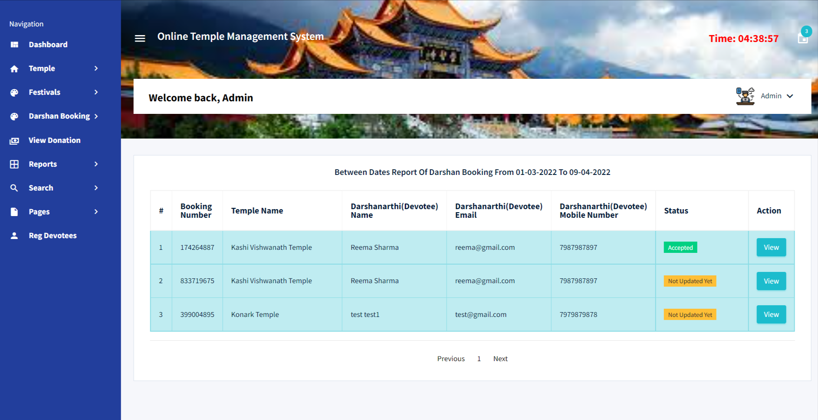

Slide 36
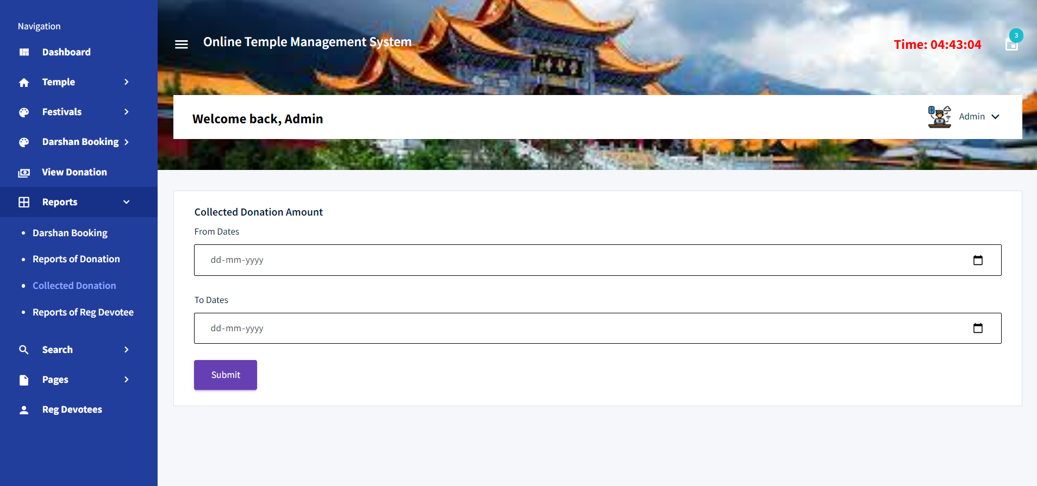
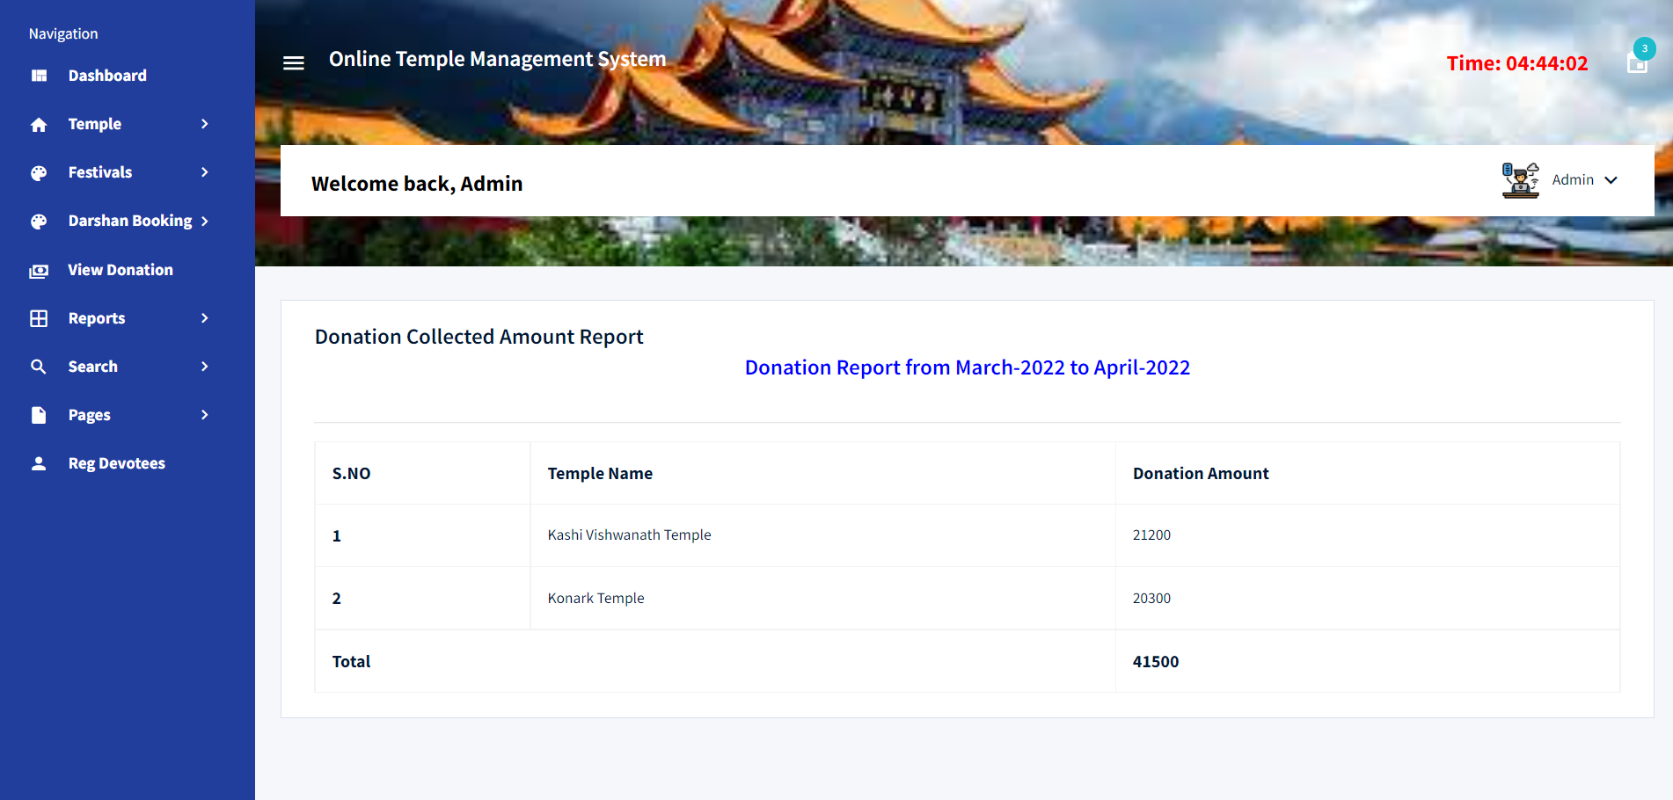

Slide 37
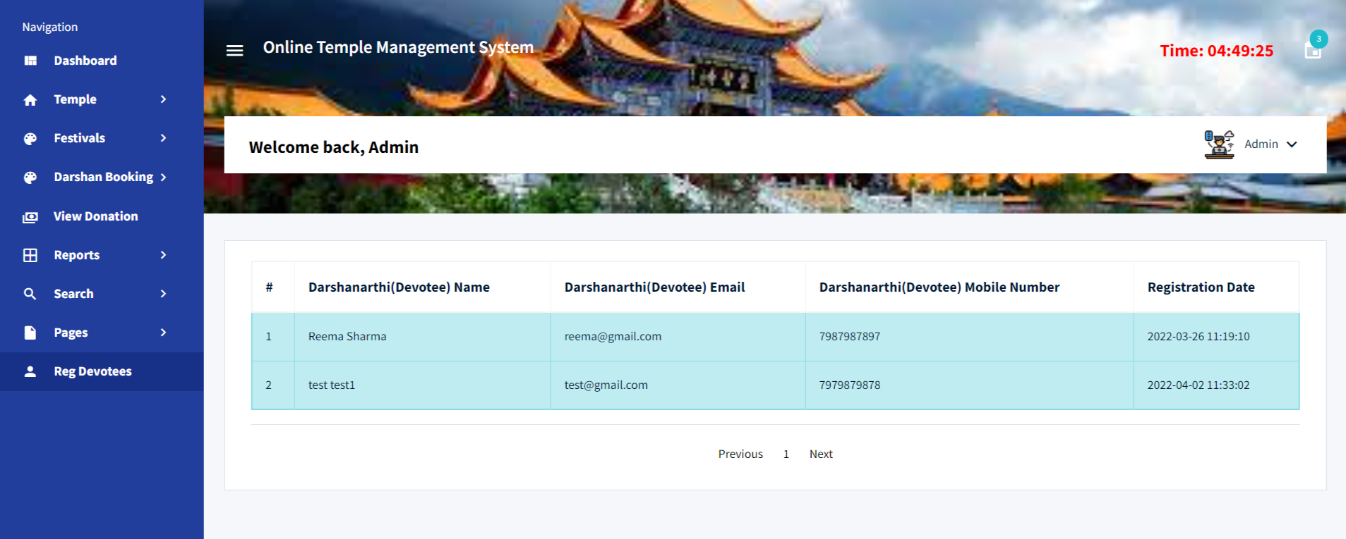

Slide 38
Conclusion
The project titled as Online Temple Management System was deeply studied and analyzed to design the code and implement. It was done under the guidance of the experienced project guide. All the current requirements and possibilities have been taken care during the project time.
Online Temple Management System can be used by temple administration to maintain the records of devotees, donation and darshan booking easily. Achieving this objective is difficult using a manual system as the information is scattered, can be redundant and collecting relevant information may be very time consuming. All these problems are solved using this project

Slide 39
Bibliography
For PHP
https://www.w3schools.com/php/default.asp
https://www.sitepoint.com/php/
https://www.php.net/
For MySQL
https://www.mysql.com/
http://www.mysqltutorial.org
For XAMPP
https://www.apachefriends.org/download.html

Slide 40

Thank u…..

